Slide 1
DOSAGE FORMS OF DRUGS DRUG FORMULATIONS
BY
DR.G.AARTHIPRIYANKA
POST GRADUATE
DEPARTMENT OF PHARMACOLOGY

Slide 2
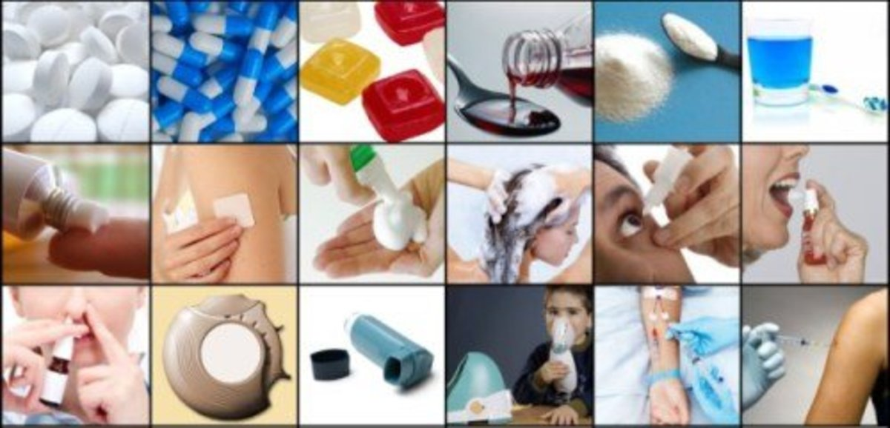
DIFFERNCE BETWEEN PHARMACY & PHARMACOLOGY???
Why do we need to know about dosage forms?

Slide 3
DOSAGE FORMS/DRUG FORMULATIONS
WHAT IS DOSAGE FORMS?
physical form of a drug/medication intended for consumption/administration.
CAN A DRUG HAVE MORE THAN ONE FORMULATIONS?
Yes,e.g Nitroglycerine – oral,SC,ointment,Inj.,transdermal patches
WHAT DEPENDS ON DOSAGE FORM?
Route of Drug administration

Slide 4
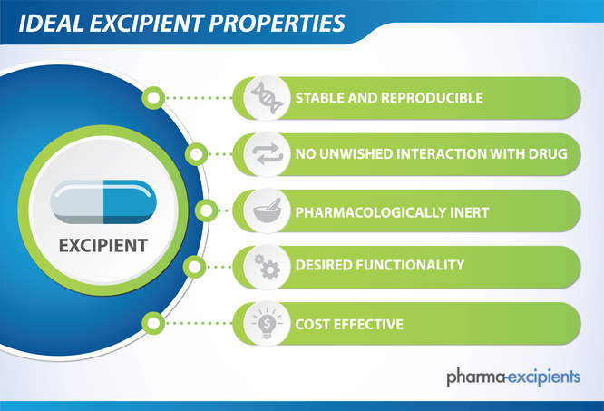
EXCIPIENTS
A Drug formulation, in addition to active therapeutic ingredients,also contains many other inactive / inert ingredients called Non-Therapeutic pharmaceutical ingredients or EXCIPIENTS

Slide 5
EXCIPIENTS
Solvents/vehicles - Base/medium to dissolve or suspend drugs - Aqueous/Non aqueous solvents
e.g., Distilled Water, Alcohol
Suspending agents - Increase viscosity of vehicle; preventing aggregation of insoluble ingredients & ensure uniform distribution of active ingredients
e.g., Gum acacia, Hydroxymethyl cellulose
Adsorbents - keep medicine dry
e.g., Magnesium Aluminium Silicate, Kaolin
Binders - hold ingredients together & give mechanical strength
e.g., Gelatin, Tragacanth gum

Slide 6
EXCIPIENTS
Disintegrants - Break up into smaller fragments
e.g., Alginate, Starch
Diluents/filters - Increases volume/bulkiness
e.g., Lactose, Sorbitol
Lubricants - Prevent adhesion of granules
e.g., Stearic Acid, Polyethylene Glycol
Glidants - To promote flow of granules/powder
e.g., Talcum, Boric Acid

Slide 7
EXCIPIENTS
Preservatives - To prevent/inhibit growth of micro organisms
e.g., Salicylic Acid, Methyl Paraben
Anti-oxidants - Prevents oxidative degradation of drug
e.g., Citric Acid, Vitamin E
Surfactants - Reduces interfacial tension
e.g., Cetrimide, Lecithin
Coating agents - Coat to protect from moisture, light, oxygen
e.g., Ethyl Cellulose, Hypromellose

Slide 8
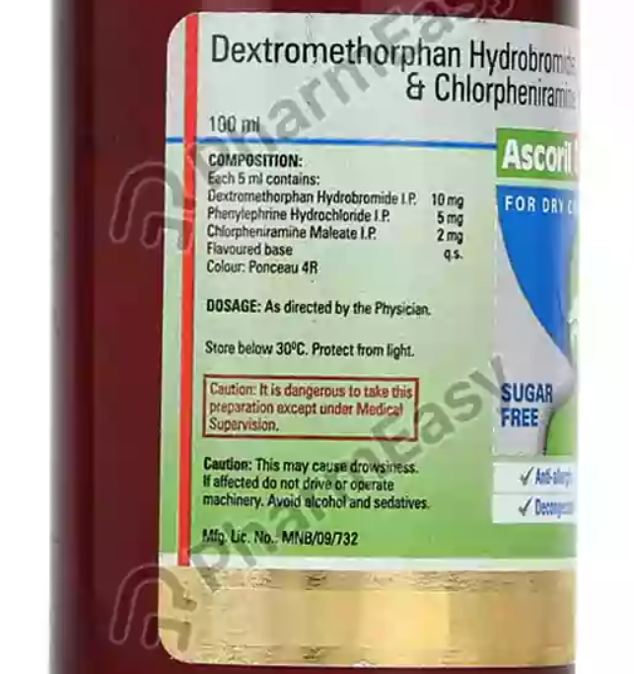
EXCIPIENTS
Flavouring agents - Clove oil, Rose oil, Orange oil, Vanilla, etc.,
Sweetening agents - Sucrose, Sorbitol, etc.,
Colouring agents - Sunset Yellow, Caramel Brown, etc.,
Others - Ointment bases, Buffering agents

Slide 9
Types of dosage forms
Liquid
Semi-solid
Solid

Slide 10
Dosage Forms
LIQUID SOLID SEMI-SOLID
Solutions 1. Powders and Granules 1. Ointment
Disperse System 2. Tablets 2. Creams
Suspensions 3. Capsules 3. Gels
Emulsions 4. Paste
Medicated Foam

Slide 11
Liquid dosage - solutions
One or more solute dissolved in a solvent.
Internal/External use.
Solutions for Oral use. E.g., Syrups, Linctuses
Solutions for IV use. E.g., NS, RL
Solutions for External use. E.g., Mouth Wash, Lotions
Solutions for instillation into body cavity. E.g., Eye drops, Nasal drops, Enema
Percentage Solutions:
Number of parts of solute in 100 parts of solvent.

Slide 12
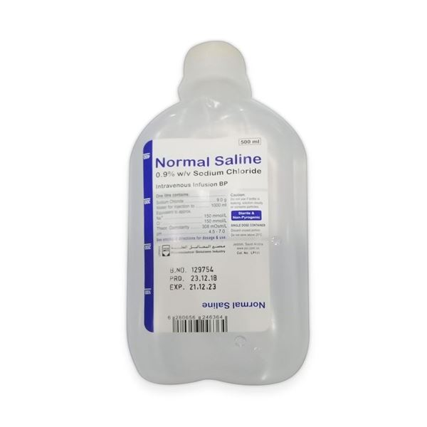
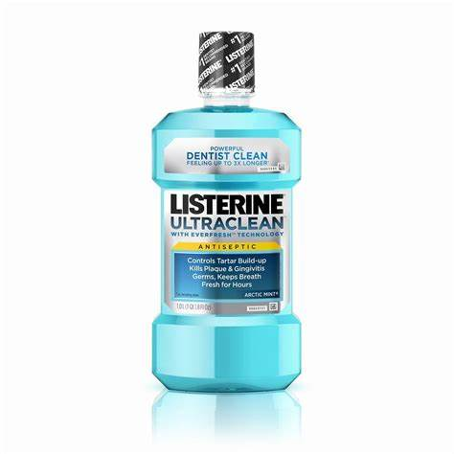
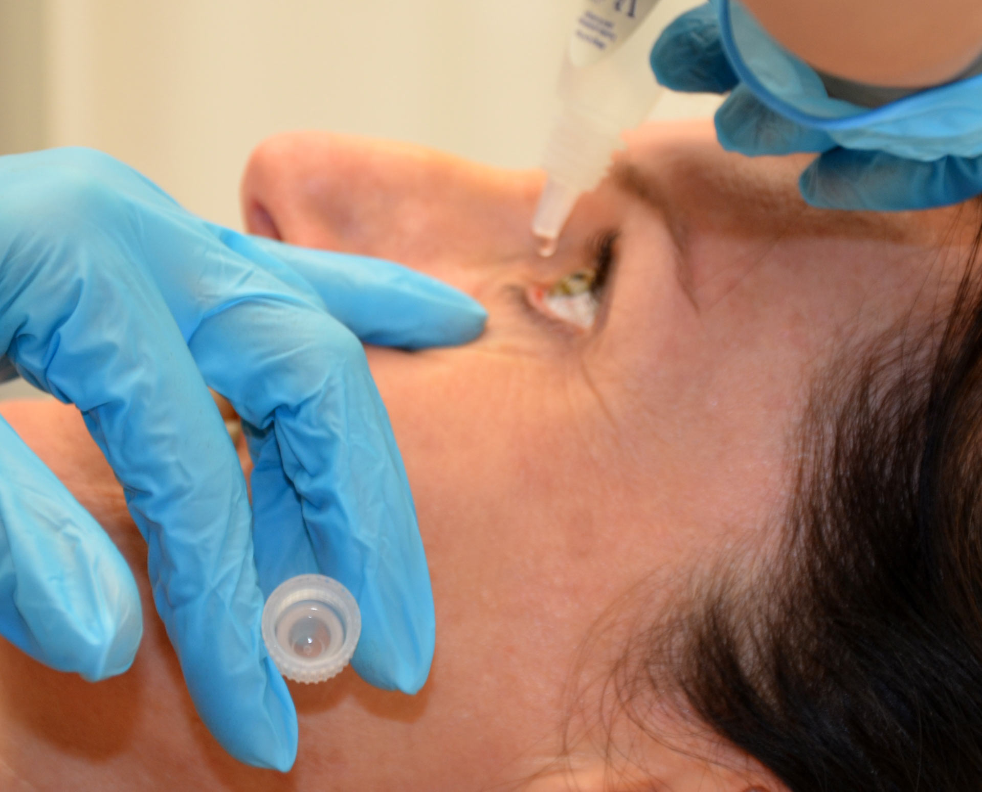

Slide 13
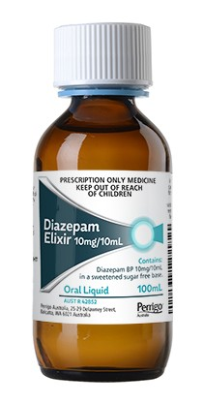
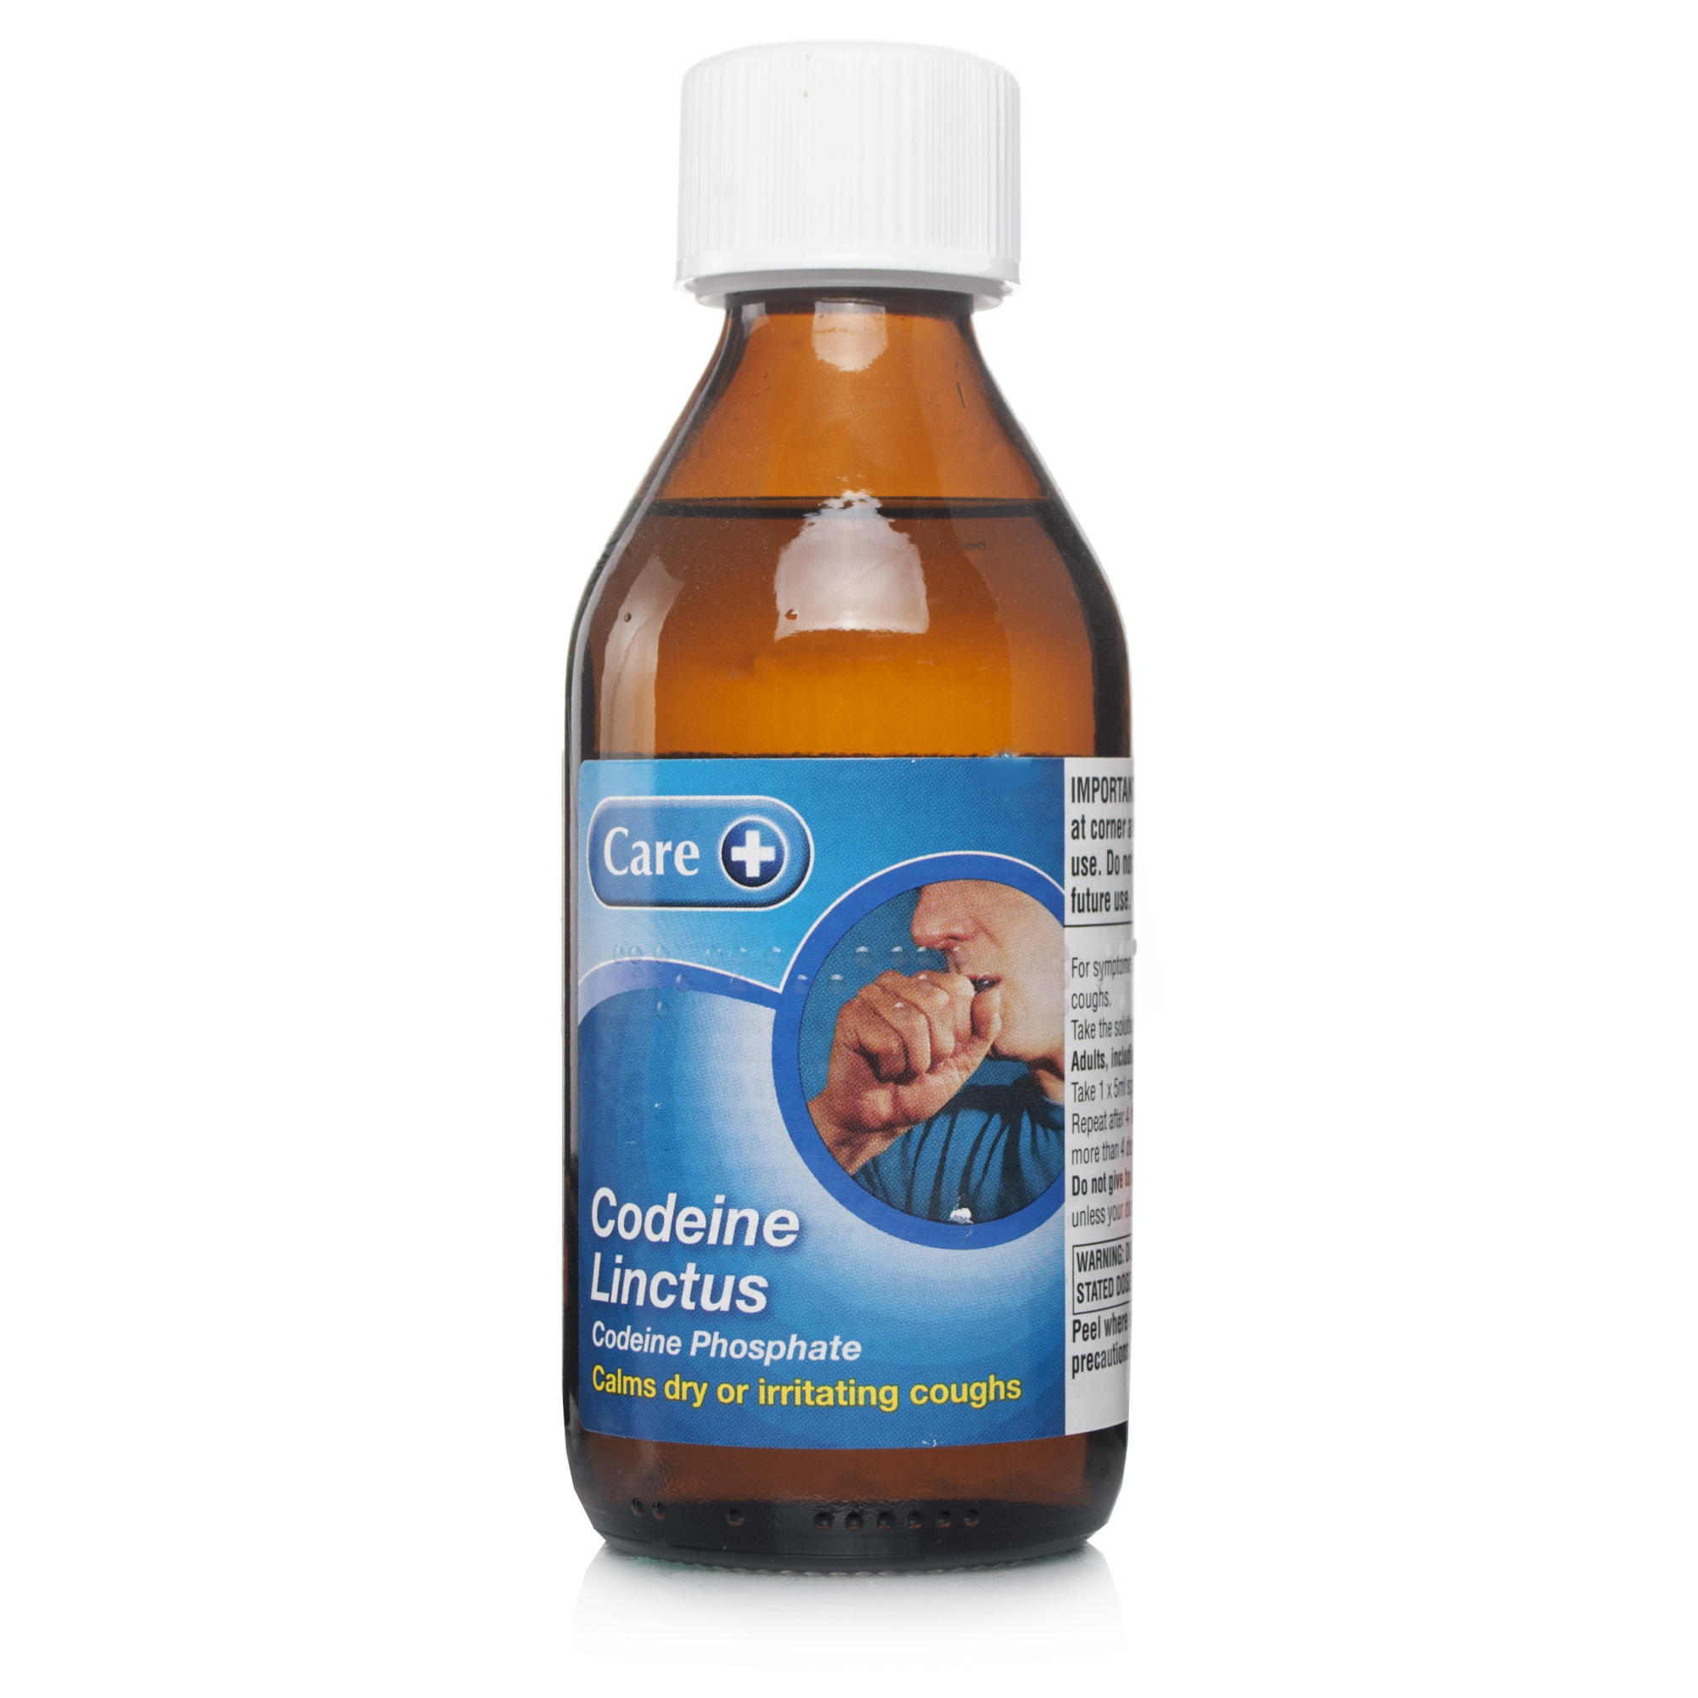
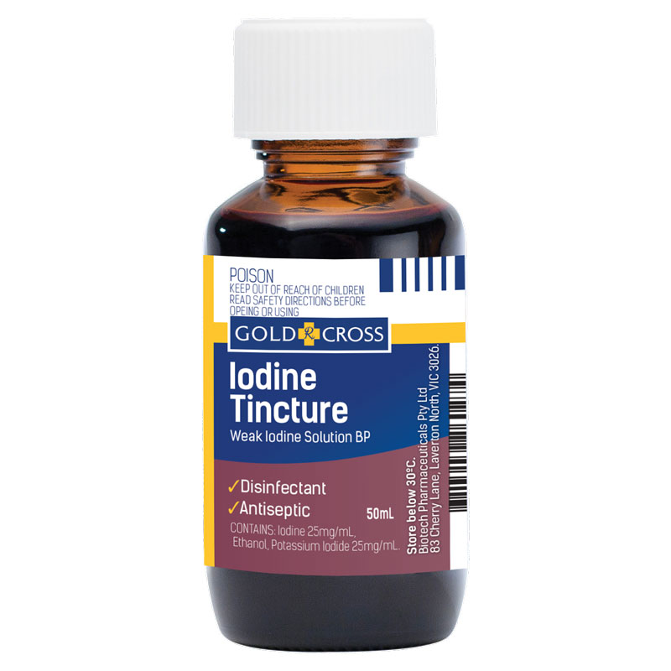
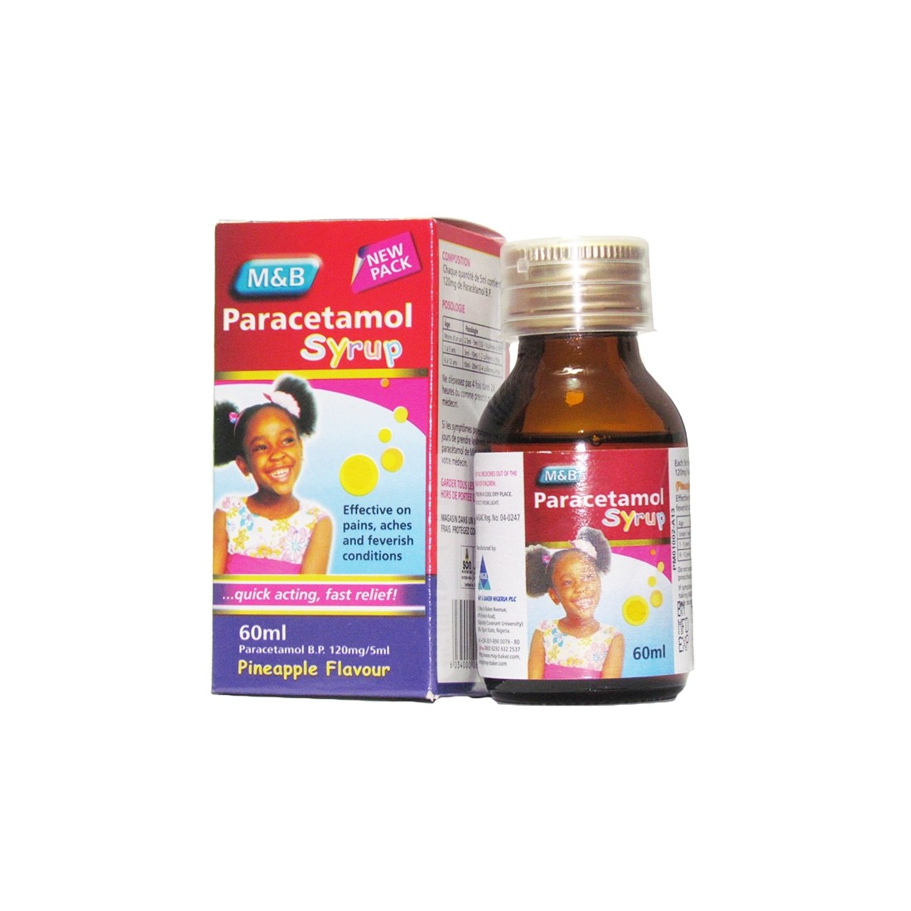

Slide 14
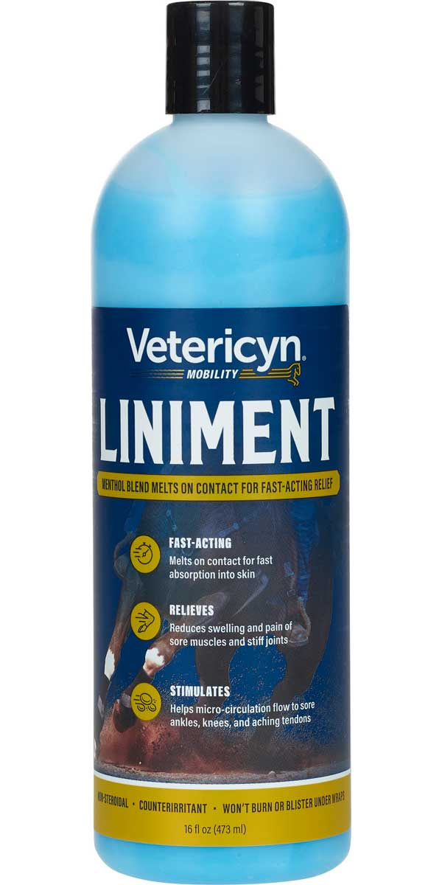
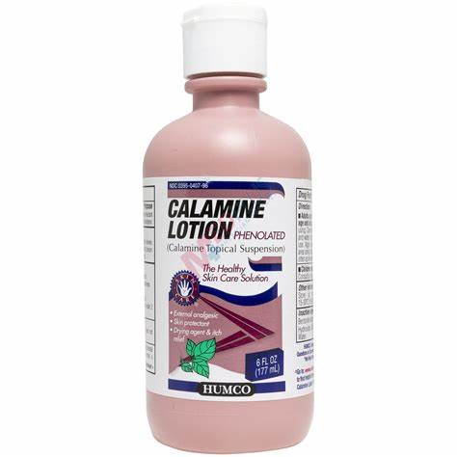
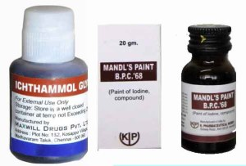

Slide 15
Liquid dosage - solutions
Syrups - Saturated solutions of sugar with active ingredients. E.g., Paracetamol
Elixir - Hydroalcoholic solutions of medicinal substance. E.g., Elixir of Diphenhydramine
Linctus - Local action on mucus membrane. E.g., Linctus codein for dry cough
Tincture - Alcoholic extraction of active ingredients from crude drug E.g., Tincture of Iodine
Irrigation Solution - E.g., Sodium Chloride Solution
Lotions - Application to skin without friction. E.g., Calamine lotion
Liniments - Application to intact skin with friction. E.g., Liniment of Turpentine
Paints - Application to skin or mucous surface by means of brush or swab. E.g., IG Paint

Slide 16
Liquid dosage – Disperse system
Immiscible drug distributed in a vehicle.
Dispersed phase – Substance distributed
Dispersing phase – Vehicle
E.g., Suspension, Emulsion, Foam

Slide 17
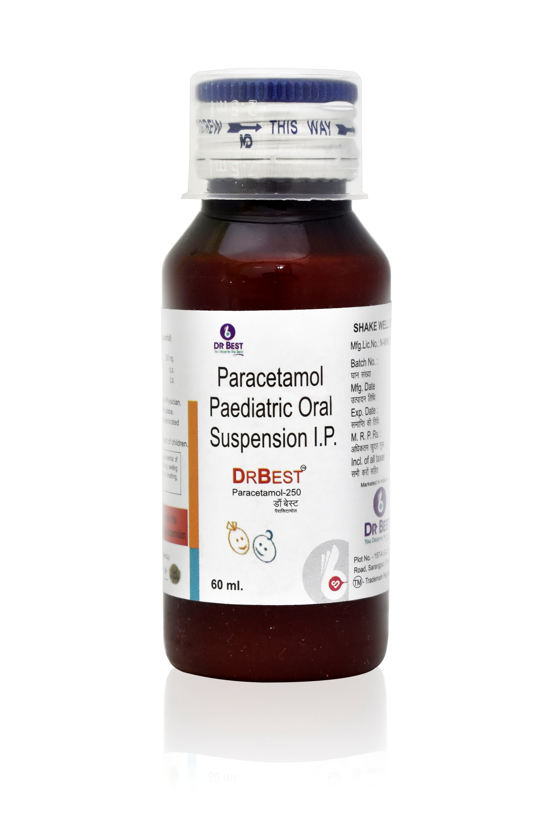
Liquid dosage – Disperse system - Suspension
Insoluble solids uniformly distributed in the vehicle with or without suspending agent.
Insoluble solids maybe diffusible/Indiffusible.
Should be shaken well before use.
Maybe used for Oral, Parenteral & External administration.
E.g., Antacid suspension, Paracetamol suspension

Slide 18
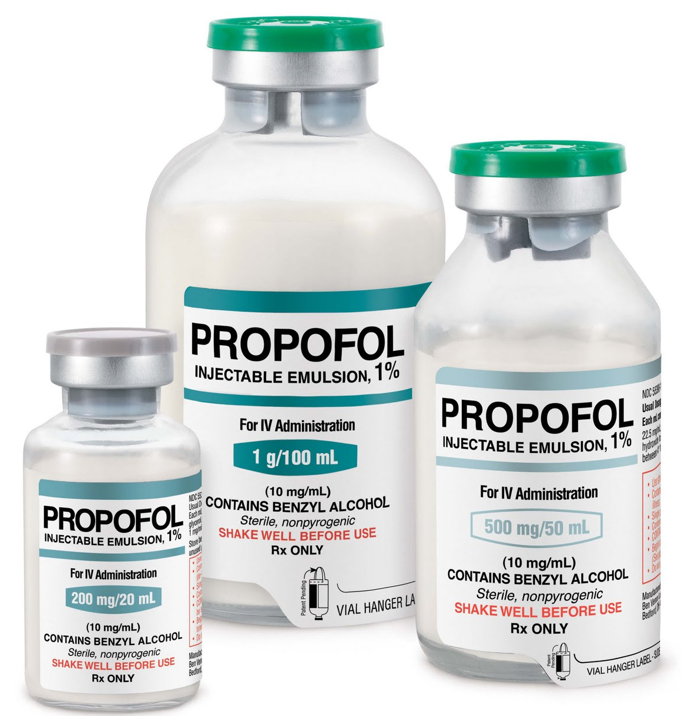
Liquid dosage – Disperse system - Emulsion
Two immiscible liquids, one of which is distributed in the form of globules throughout the other with the help of third substance called emulsifying agent.
Can be used for Oral, Topical, Parenteral administration.
Advantages:
Absorption is rapid.
More Palatable.
Types:
Oil in Water type. E.g., Milk and Castor Oil emulsion, Propofol IV.
Water in Oil type. E.g., IM Depot Testosterone Propionate Injection.

Slide 19
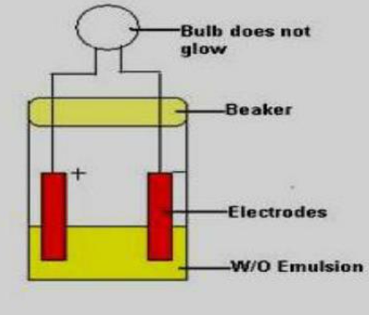
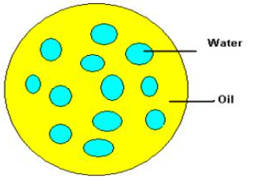
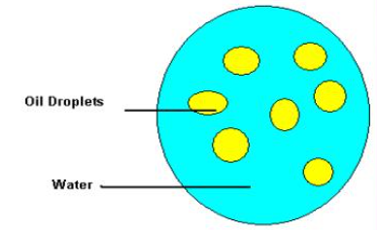
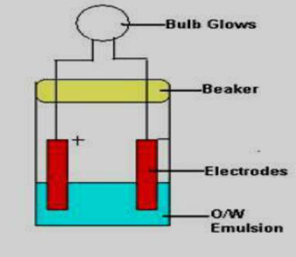
Emulsifying Agents
Reduces interfacial tension and ensure uniform distribution.
Emulsifying agents for Water in Oil type. E.g., Wool fat, Bees Wax.
Emulsifying agents for Oil in Water type. E.g., Egg yolk, Casein.

Slide 20
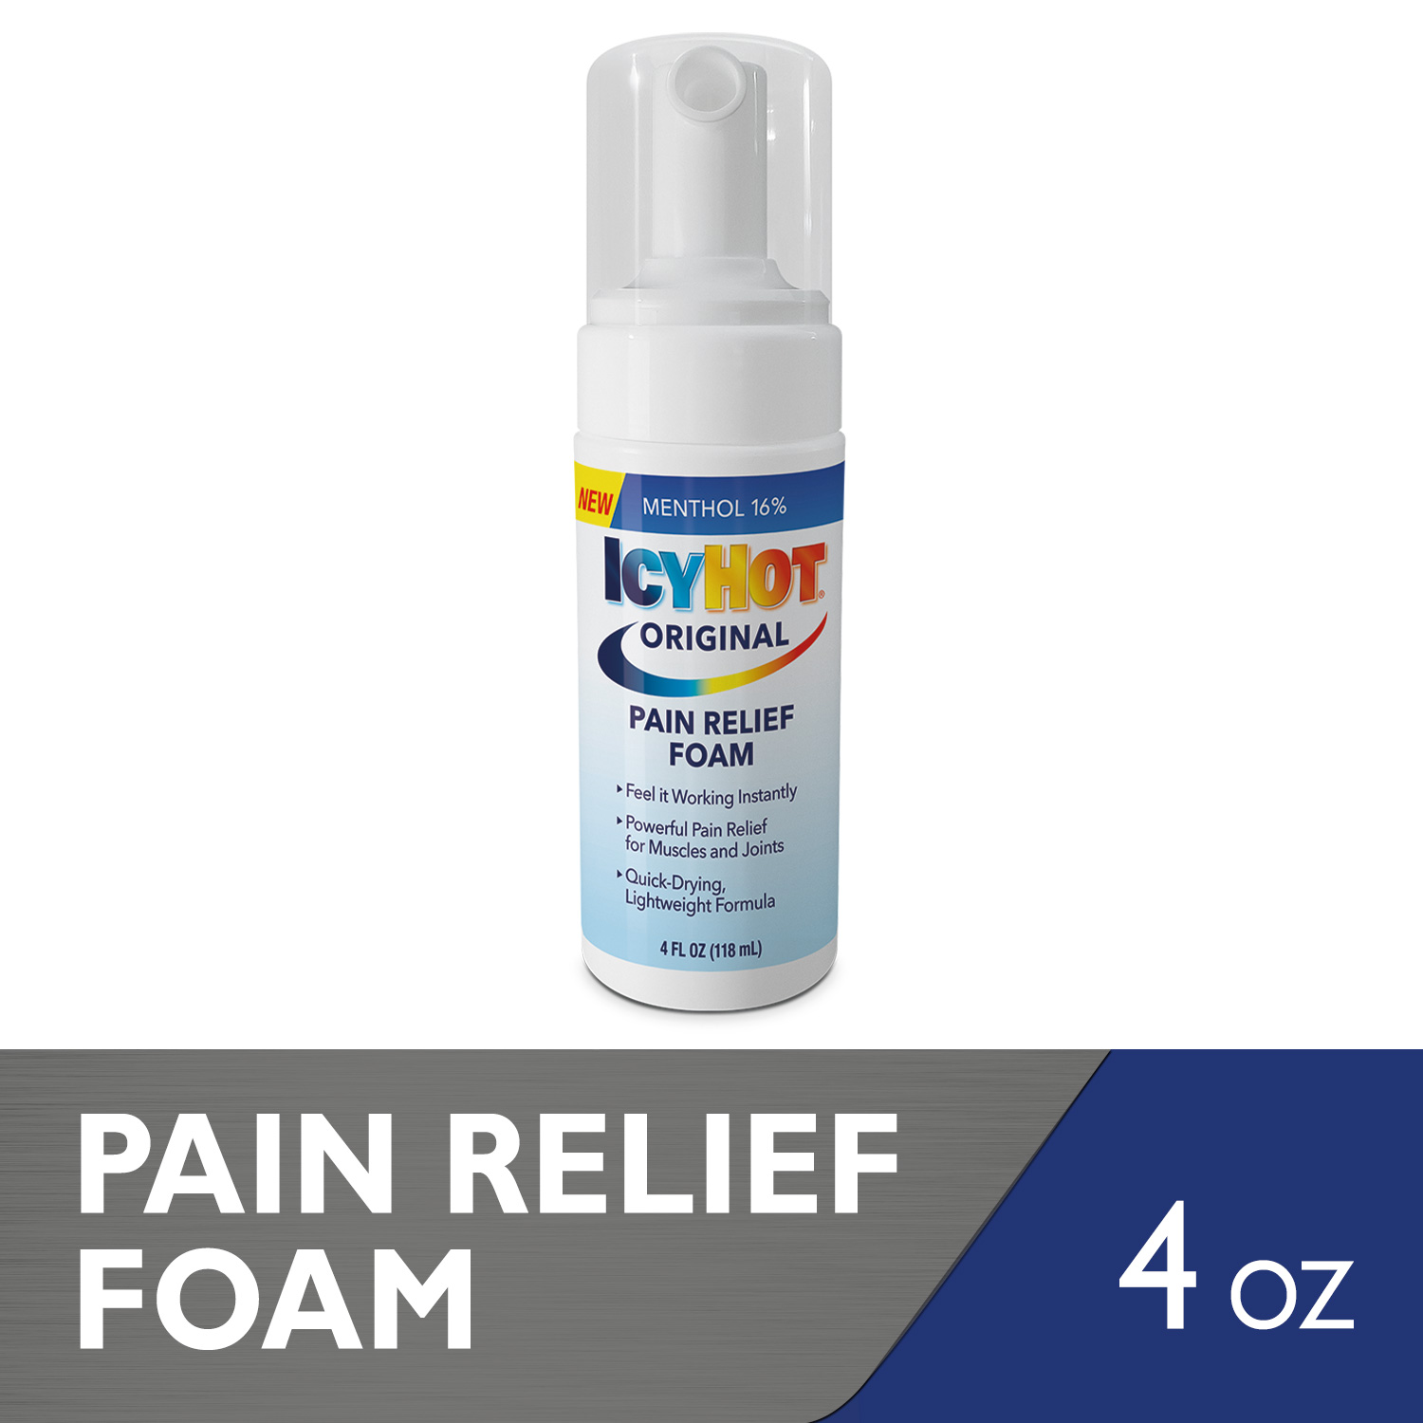
Liquid dosage – Disperse system – Medicated Foam
Large volumes of gas bubbles dispersed in liquid phase containing active ingredient.
Advantages:
Good Spreadability.
Faster Absorption.
Easy application on Sore, Inflamed and Hirsute areas.
Types;
Dermal foams E.g., Steroids for eczema
Rectal foams E.g., Hydrocortisone acetate foam in IBD
Vaginal foams E.g, Spermicidal foams for contraception

Slide 21
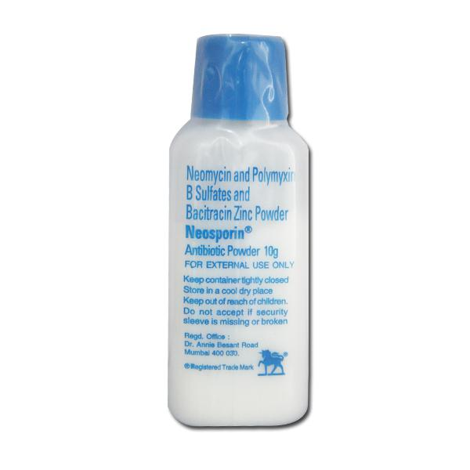
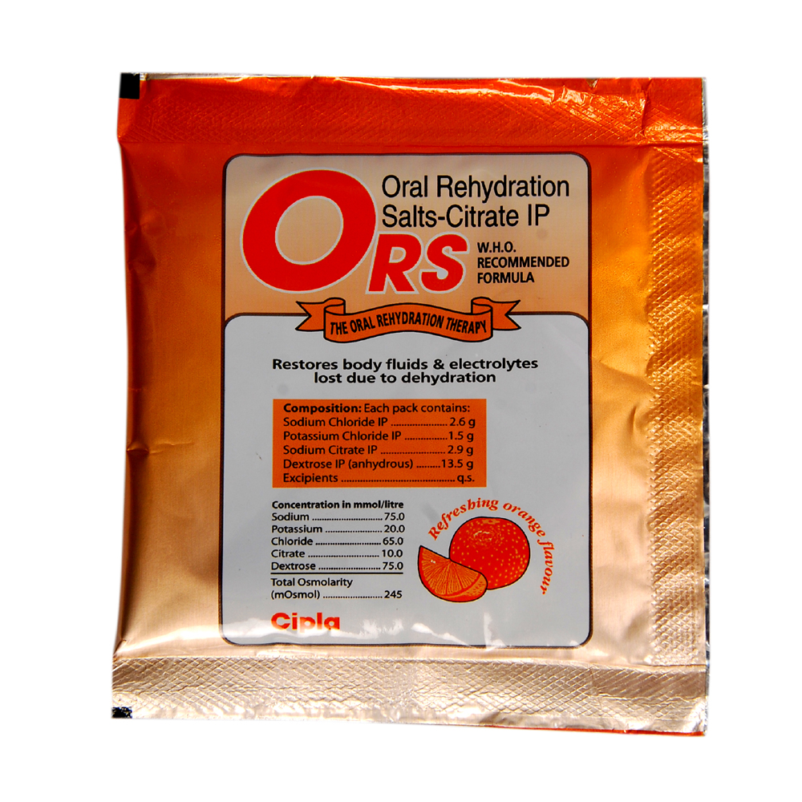
SOLID Dosage - Powders
Drugs in finely divided state.
0.1 micron to 10 microns.
Advantages:
Rapid onset
Preferred in children
When a drug is too bulky

Slide 22
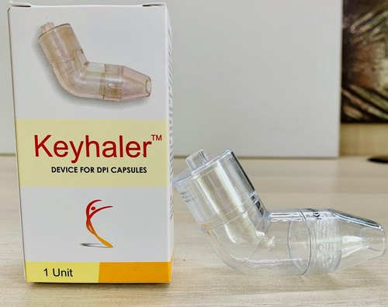
SOLID Dosage - Powders
Types:
Powders for Oral use. E.g., ORS Powder
Dusting Powder. E.g., Neosporin powder
Insufflation Powder – Introduced into body cavity with the help of insufflators.
Aerosol Powders. E.g., DPI
Powders for reconstitution. E.g., Penicillin-G powder in vial for injection.
Douche powder – Cleaning body cavities.
Dentifrices E.g., Tooth powder

Slide 23
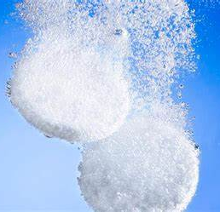
SOLID Dosage - GRANULES
EFFERVESCENT GRANULES:
Dry aggregates of powder particles.
Contain sodium bicarbonate along with citric acid/tartaric acid in addition to the active ingredient.
When added to water, carbon dioxide is released
E.g., Acetyl cysteine Effervescent Granules (Mucolytic)

Slide 24
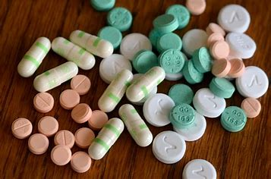
SOLID Dosage - TABLETS
Active drugs with or without diluents, prepared by compression or by molding method.
shapes
ADVANTAGE:
Simple,Economical,Stable,Convenient to Carry,Accurate,Easy for Administration & Most popular dosage forms

Slide 25
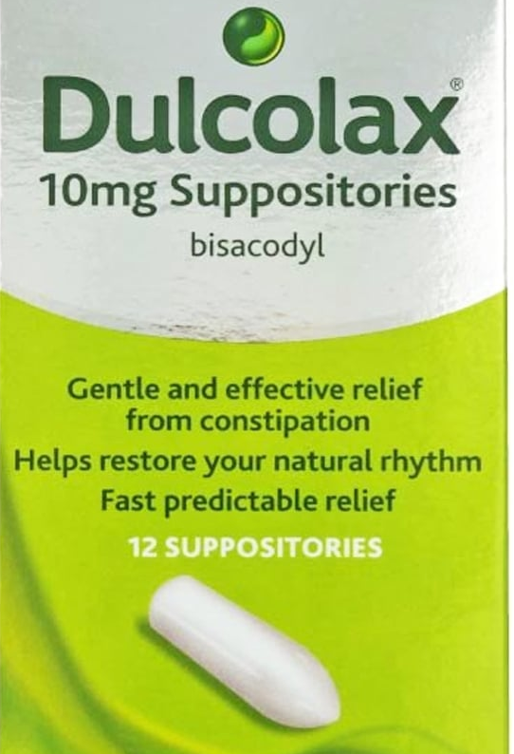
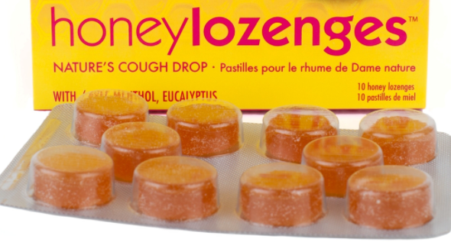
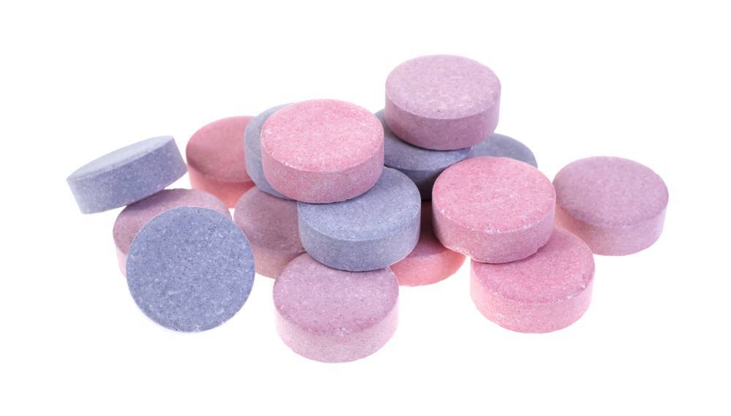
SOLID Dosage - TABLETS
TYPES OF TABLETS:
Simple uncoated oral tablets
Sugar coated tablets
Enteric coated tablets
Mouth dissolving/orally disintegrating tablets
Dispersible tablets
Chewable tablets
Buccal & Sublingual tablets
Lozenges & Troches
Sustained release/ Extended release tablet (SR/ER)
Suppositories
Urethral inserts/Bougies

Slide 26
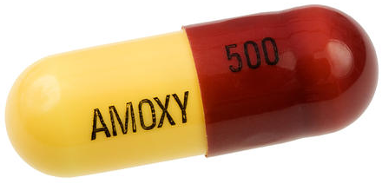
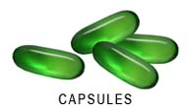
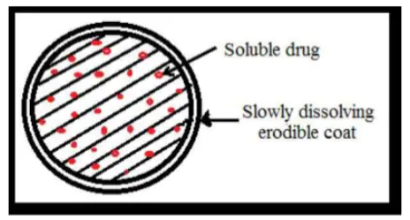
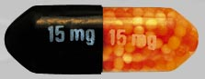
SOLID Dosage - CAPSULES
Medical agents are enclosed in a small shell of Gelatin
HARD CAPSULES:
2 pieces- long body & shorter cap. E.g., Amoxicillin Capsules
SOFT CAPSULES:
1 piece –various shapes E.g., Vit E capsules
SPANSULES:
Capsules containing drug granules with special pharmaceutical formulation to be disintegrated & dissolved at different times for prolonged duration of action. E.g., Sustained release capsule of Ferrous Sulphate

Slide 27
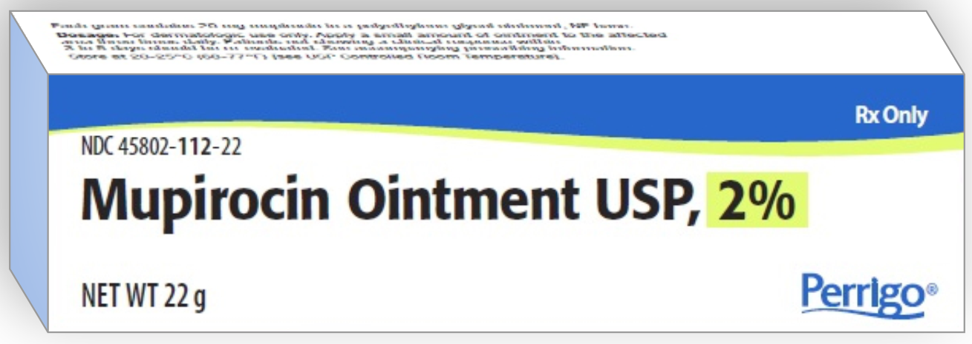
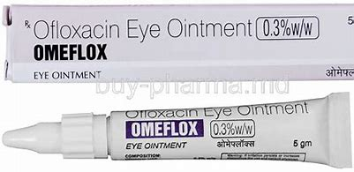
SEMISOLID - OINTMENT
External application to skin & mucous membrane
Bases used for Dispersing ointment are
Hydrocarbon Bases – Vegetable oils, liquid paraffin
Absorbtion Bases – Wool Fat,Wool Alcohol
Water soluble Bases – Poly ethylene Alcohol
E.g., Mupicirocin ointment
Ofloxacin eye ointment

Slide 28
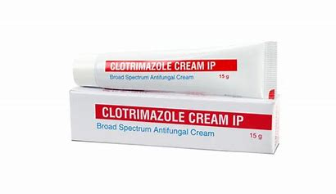
SEMISOLID - CREAMS
Semisolid emulsion of either O/W or W/O type intended for external application of skin/Mucous membrane
E.g., Clotrimazole cream

Slide 29
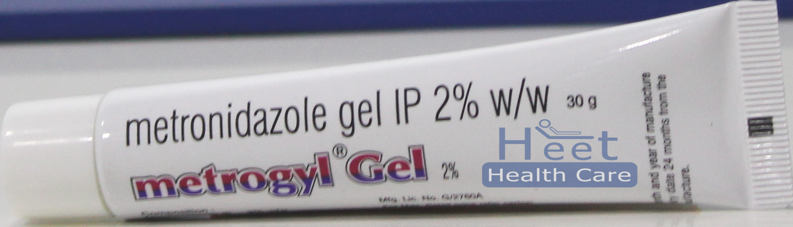
SEMISOLID - GELS
Dispersion of small/large molecules in liquid vehicle rendered jelly like by addition of gelling agents intended for topical application to skin & mucous membrane
E.g., Metronidazole gel

Slide 30

SEMISOLID - PASTE
Intended for application to skin
Stiffer & Nongreasy
E.g., Zinc Oxide paste for diaper rash

Slide 31
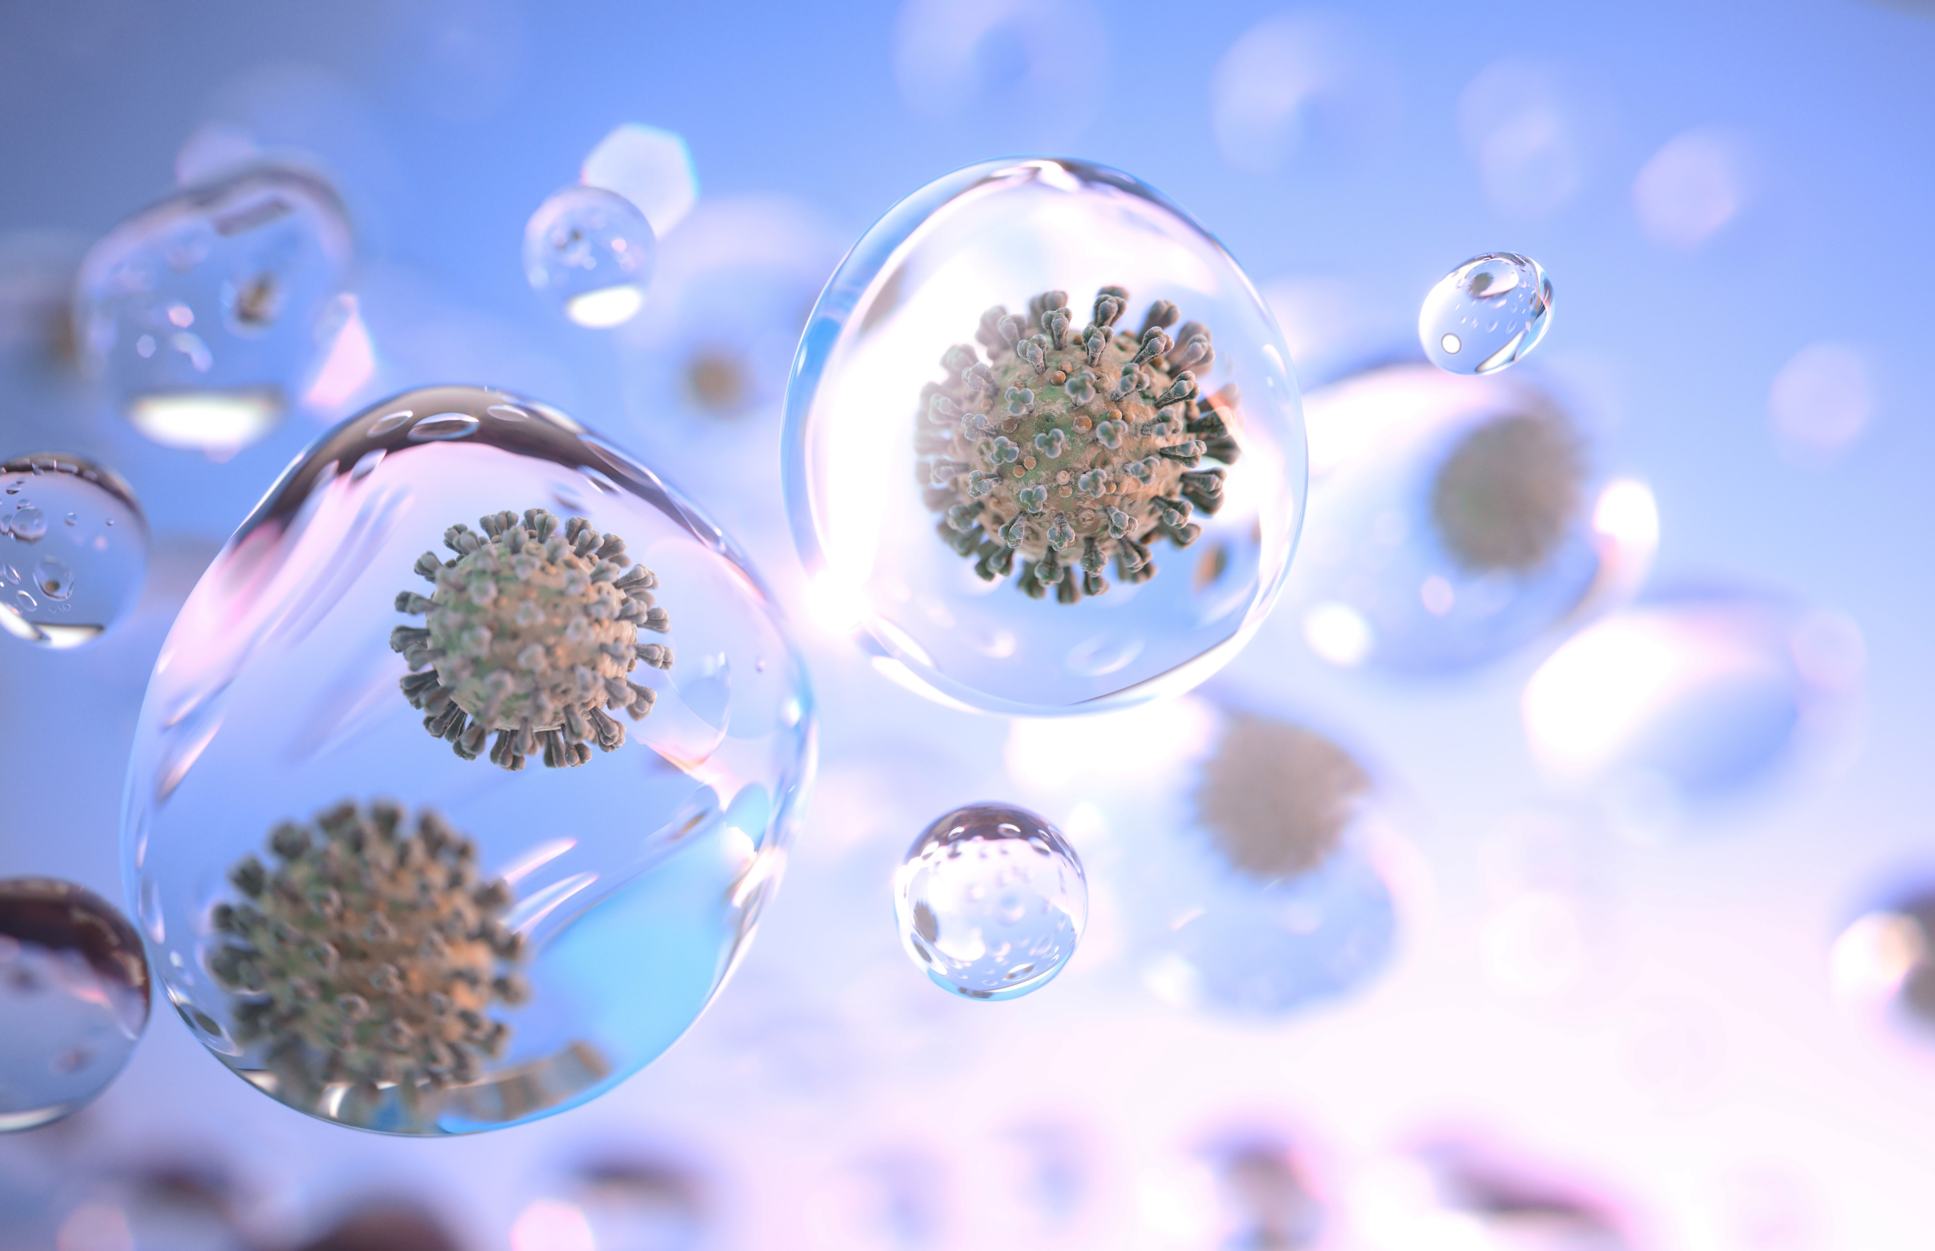
AEROSOLS
Colloidal system/Disperse system consisting of very finely divided liquid or solid particles suspended in Gas (propellant).
Propellant helps to expel the product & also act as solvent & diluent.
Propellant – Liquified gas of Hydro Fluro Alkane
Ideal particle size – 2 to 5 micrometer MMDA (Mass Media Aero Dynamic Diameter)

Slide 32
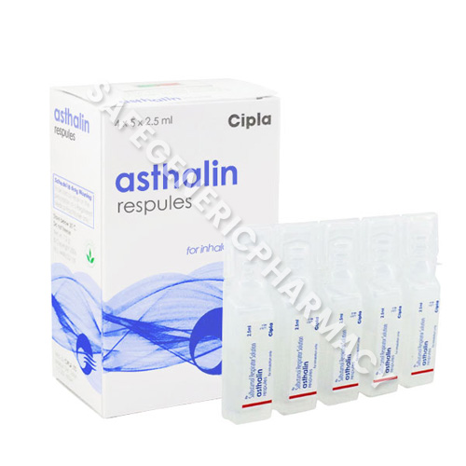
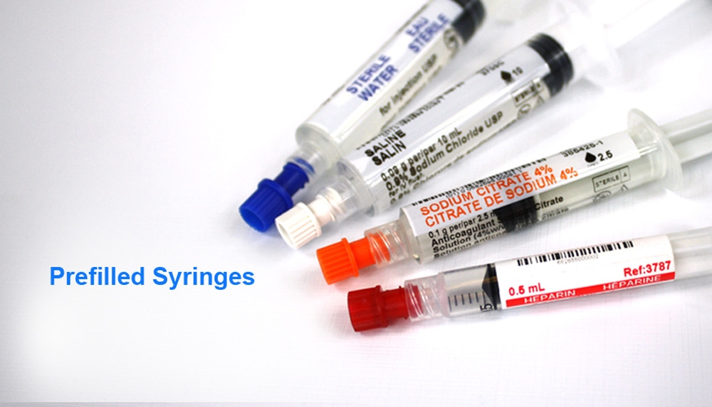
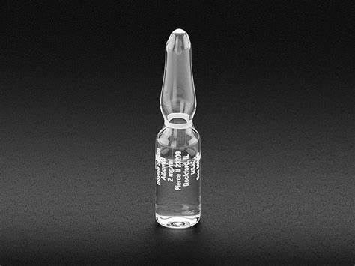
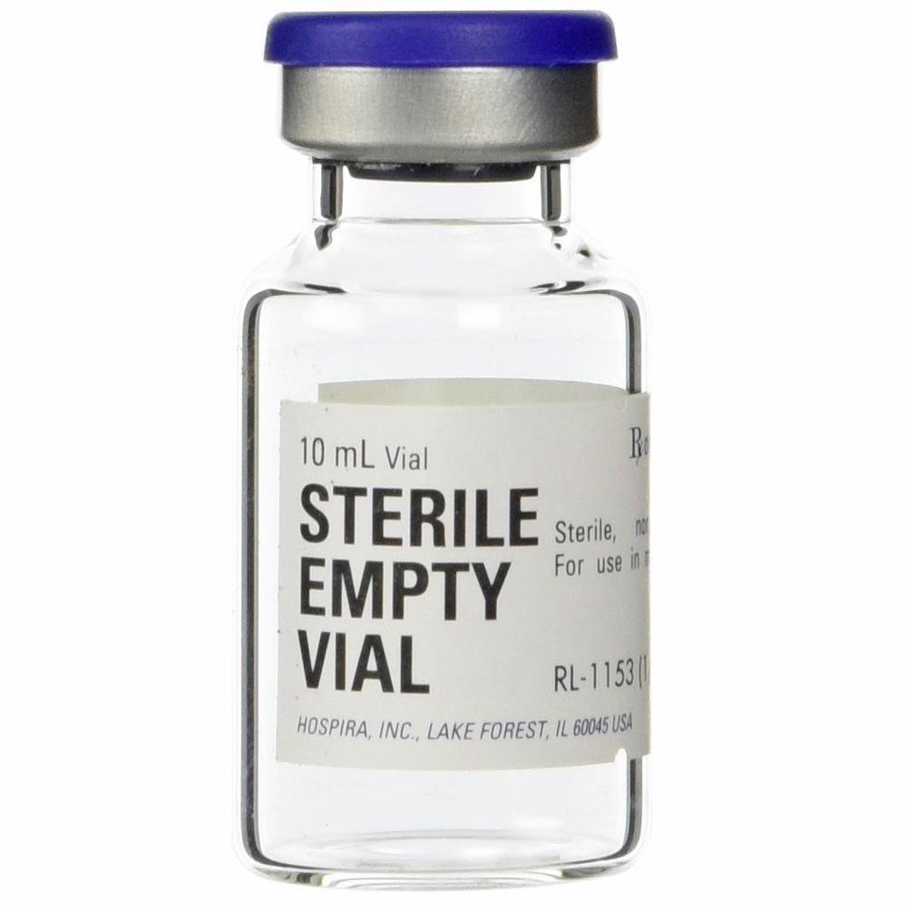
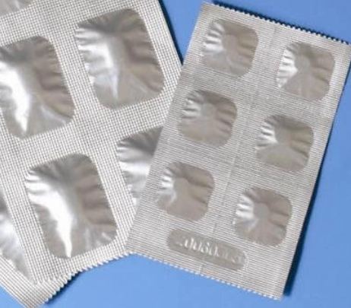
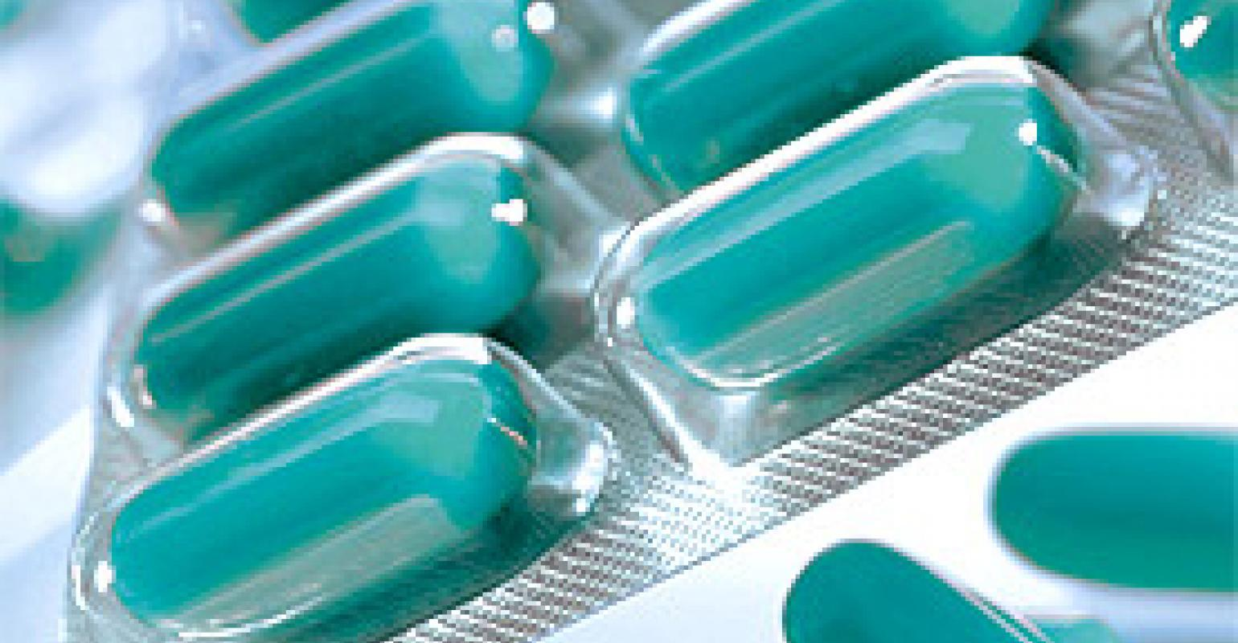
Packaging
Protects active ingredients from light,heat,moisture,oxidation,microbial contamination & damage due to handing.
Bottle
Vial
Ampoule
Strip packaging
Blister packaging
Collapsible tube
Flexible PVC Plastic bags
Aerosol containers
Respules
Prefilled syringes
Cylinder

Slide 33
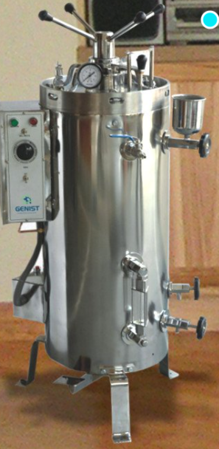
STERILIZATION
Dry heat – instruments,oils,glassware,dusting powders
Moist heat –BOILING – T-100 C :AUTOCLAVING –T-125C
Pasteurization -80C -Milk
Tyndalisation – thermolabile substances

Slide 34
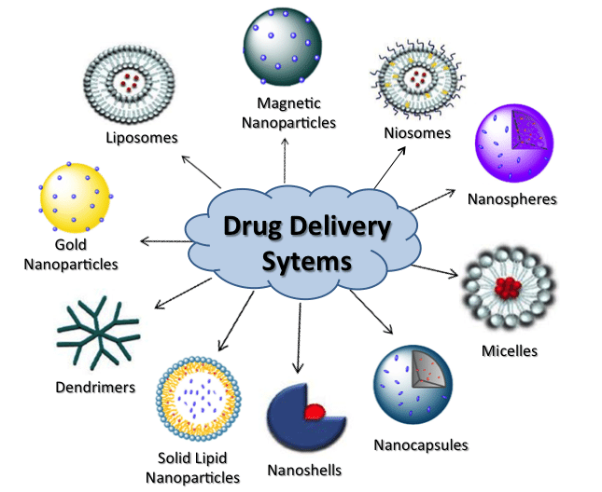
DRUG DELIVERY SYSTEM
Technique/method/process that enable a therapeutic agent/drug to selectively reach its site of action to achieve desired therapeutic effects in humans.

Slide 35
DRUG DELIVERY SYSTEM - ADVANTAGES
Decrease biodegradation & Increase Bioavailability
Improved rate of Drug Delivery
Decrease fluctuation in steady state level
Decrease adverse effects
Site specific targeting
Decrease total health care cost
Enhanced product Efficacy
Improved patient convenience & compliance

Slide 36
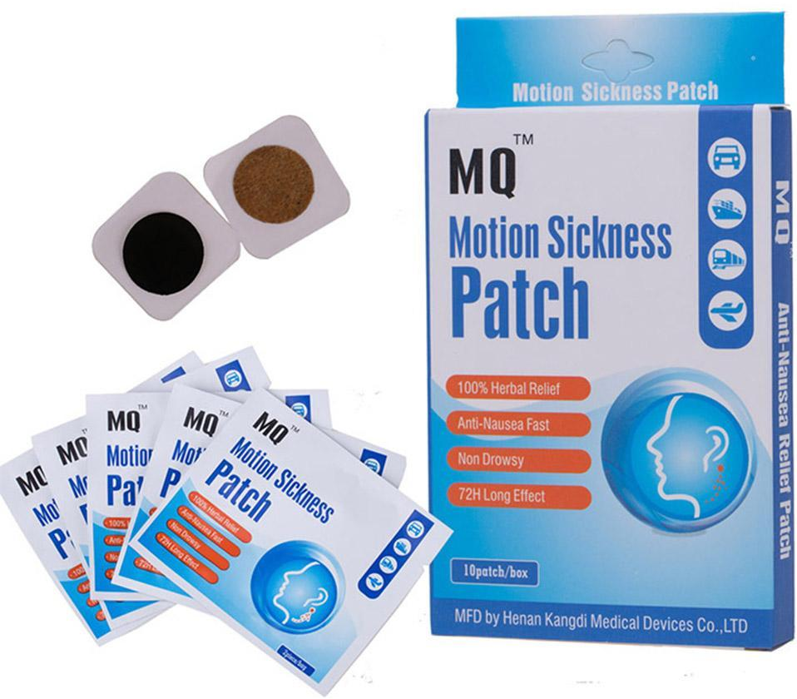
TRANSDERMAL DDS
Adhesive skin patches which permits absorption of drug through skin & deliver it into systemic circulation at controlled rate.
E.g., scopolamine patch

Slide 37
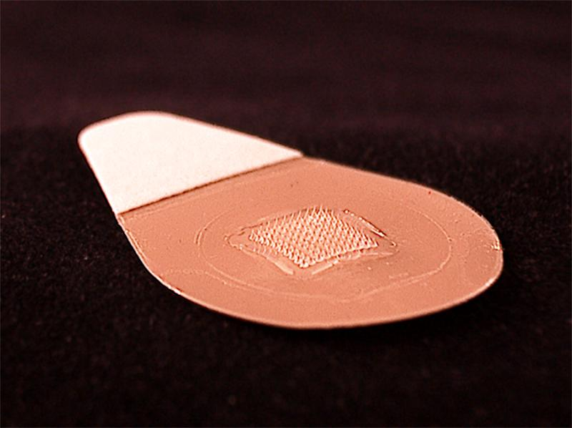
DDS - MICRONEEDLES PATCH
Large molecules like oligonucleotides,vaccines,peptides,hormones,cancer therapy

Slide 38
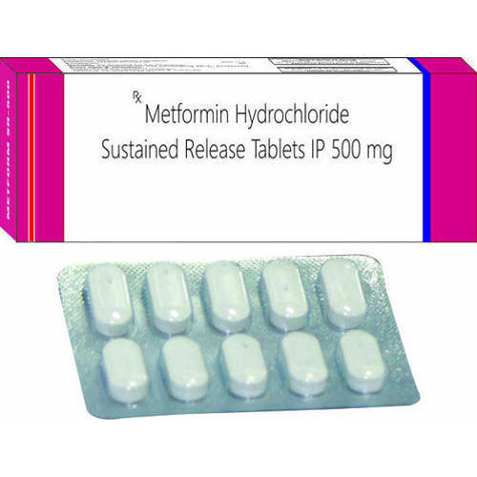
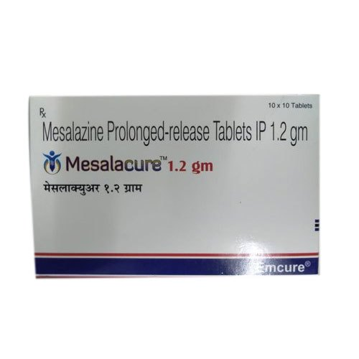
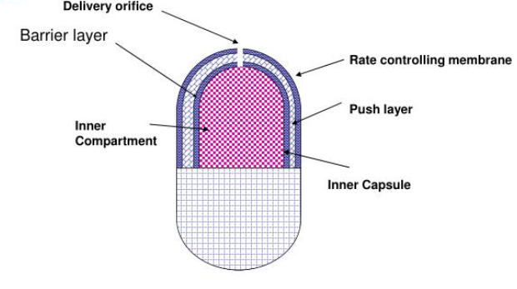

DDS - ORAL
Gastro retention delivery system
Colon specific DDS
Medicated chewing gums
Osmotic pumps

Slide 39


OPTHALMIC DDS
Ocular inserts
Delivery through carriers
Ocular sprays
Ocular iontophoresis

Slide 40


Vaginal dds
Mucoadhesive VDDS
Vaginal inserts
Vaginal rings
VDD through carriers

Slide 41

IMPLANTS

Slide 42


OTHER TYPES OF DDS
Parental infusion pumps
Syringe pumps
Volumetric pumps
Microchip drug delivery
Dermo jet

Slide 43
TARGETED DRUG DELIVERY (TDDS)
Target: specific organ/tissue/cell which need treatment
Drug: should be effective at the site. compatible with carrier
Carrier/vehicle: molecule or system required for effective transport & delivery of loaded drug to the target

Slide 44

NANO PARTICLES

Slide 45

NANOCRYSTALS

Slide 46
NATURAL SYSTEMS
Released erythrocytes, Ghost erythrocytes, LDL Lipoproteins used as Carriers

Slide 47
THANK YOU ALL

